Slide 1
CENG 201
–
Stack (LİFO)
LAB 4

Slide 2
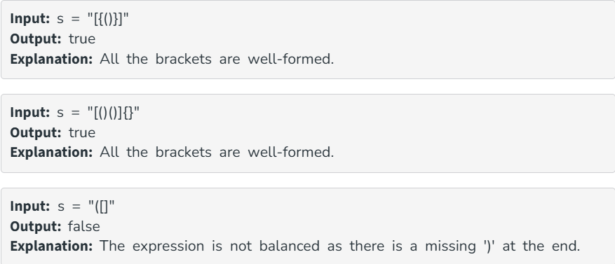
Exercise 1:
Parenthesis Checker
Problem Statement: Given a string s, composed of different combinations of '(' , ')', '{', '}', '[', ']'. Determine whether the Expression is balanced or not.
An expression is balanced if:
1. Each opening bracket has a corresponding closing bracket of the same type.
2. Opening brackets must be closed in the correct order.
Create a Project named CENG201_LAB4:
1. BracketStack.java
2. BalancedBrackets.java
3. BracketBalancedDemo.java

Slide 3
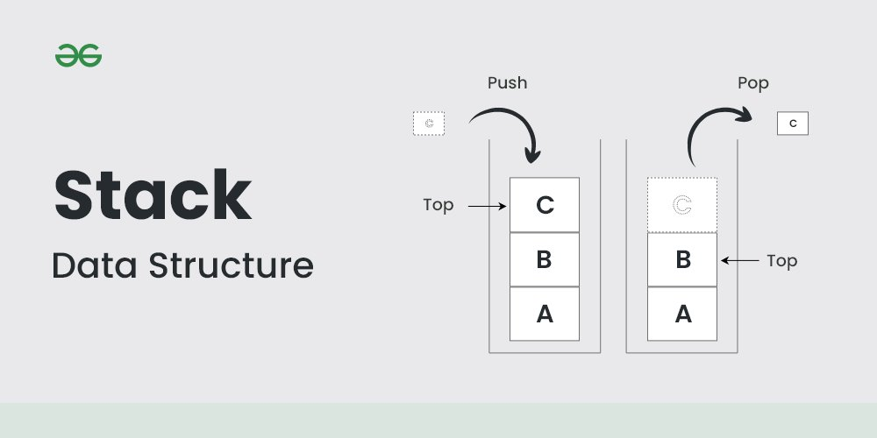
Exercise 1: Parenthesis Checker
Add an element to the top of the stack
Add an element to the top of the stack. LİFO (Last In First Out)
newNode
2. (New)TOP
1. newNode.next = top;
2. top = newNode;
1. newNode.next = top;
TOP
B
A

Slide 4
Exercise 1: Parenthesis Checker
Remove and return the top element
TOP
Remove and return the top element of the stack.
POP
C
1. char value = top.data;
TOP
C
1. char value = top.data;
2. top = top.next;
3. return value;
B
2. (NEW) top = top.next;
(NEW) TOP
A

Slide 5
Exercise 1: Parenthesis Checker isBalanced() function
To determine whether the expression is balanced or not
1. Traverse the string character by character. (for loop)
2. If the character is an opening bracket,
push it onto the stack.
3. If it is a closing bracket:
- a. Check whether the stack is empty.
- b. Pop the top opening bracket.
- c. Check whether the brackets match (isMatchingPair() method)
4. At the end, check whether the stack is empty.
TOP
(
Control of opening bracket → PUSH
{
Control of opening bracket → PUSH
String=
[
{
(
)
}
]
[
Control of opening bracket → PUSH

Slide 6
Exercise 1: Parenthesis Checker isMatchingPair() function
opening
current
Check: ( matches ) → return true
Check: [ matches ] → return true
Check: { matches } → return true
if check doesnt match → return false
(isMatchingPair() method).
POP the TOP
(
)
Closing bracket
Check: ( matches ) → return true
opening
current
POP the TOP
{
}
Closing bracket
Check: { matches } → return true
String=
[
{
(
)
}
]
(
TOP
{
[

Slide 7
Exercise 1:
Parenthesis Checker
Hints:
- Add an element to the top: newNode.next = top; // top = newNode;
- Remove and return the top element: After saving top.data, the new top should be the node that comes after the current top.
- peek: Control if the stack is empty; if it is, then return null // if not, return the data of the top.

Slide 8
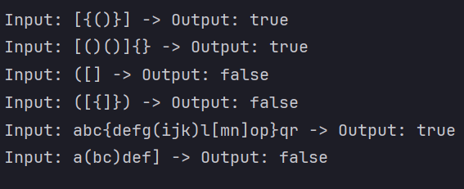
EXPECTED OUTPUT

Slide 9
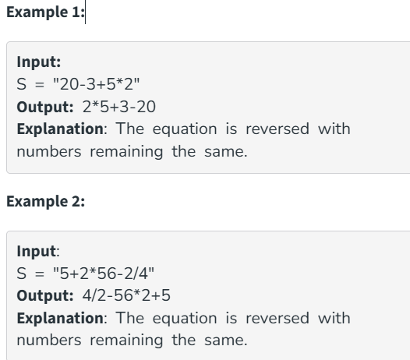
Exercise 2:
REVERSİNG THE EQUATİON
Problem Statement: Given a mathematical equation that contains only numbers and +, -, *, /
Print the equation in reverse, such that the equation is reversed, but the numbers remain the same.
It is guaranteed that the given equation is valid, and there are no leading zeros.
Create a Project named CENG201_LAB4:
1. TokenStack.java
2. EquationReverser.java
3. ReverseEquationDemo.java

Slide 10
Exercise 2: REVERSİNG THE EQUATİON push()
2
TOP
*
BE CAREFUL!! When numbers appear consecutively, treat them as a single number. DO NOT SEPARATE THEM.
String= 20-3+5*2
Output=2*5+3-20
5
+
Hints:
- Check whether the current character is a digit. (Use Character.isDigit(current))
- Remember where the number starts( int start = i)
- Move forward while the characters are digits (i++)
- Extract the entire number and push it (Use substring(start, i))
- Push the operator(Use String.valueOf(current))
3
-
20

Slide 11
Exercise 2: REVERSİNG THE EQUATİON pop()
2
TOP
*
Last İn First Out
Pop(2)
Pop(*)
Pop(5)
Pop(+)
Pop(3)
Pop(-)
Pop(20)
5
+
Output= 2*5+3-20
3
-
20

Slide 12
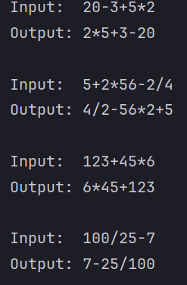
EXPECTED OUTPUT

